Slide 1
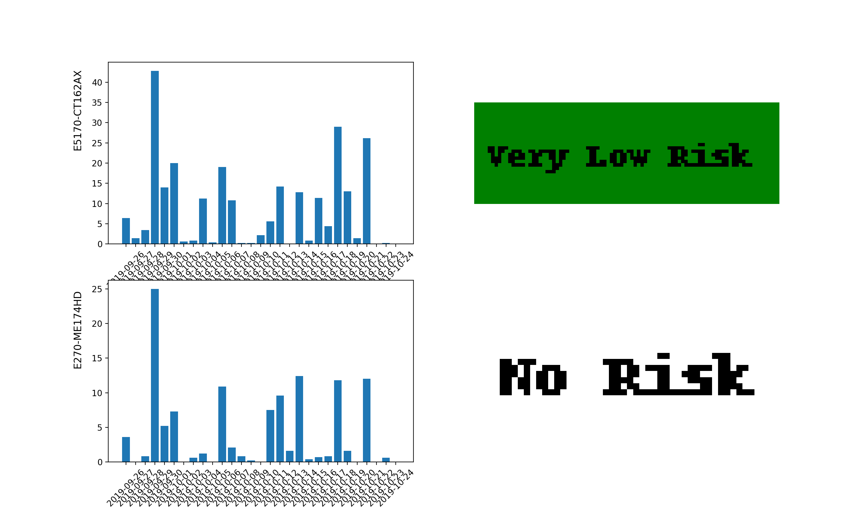
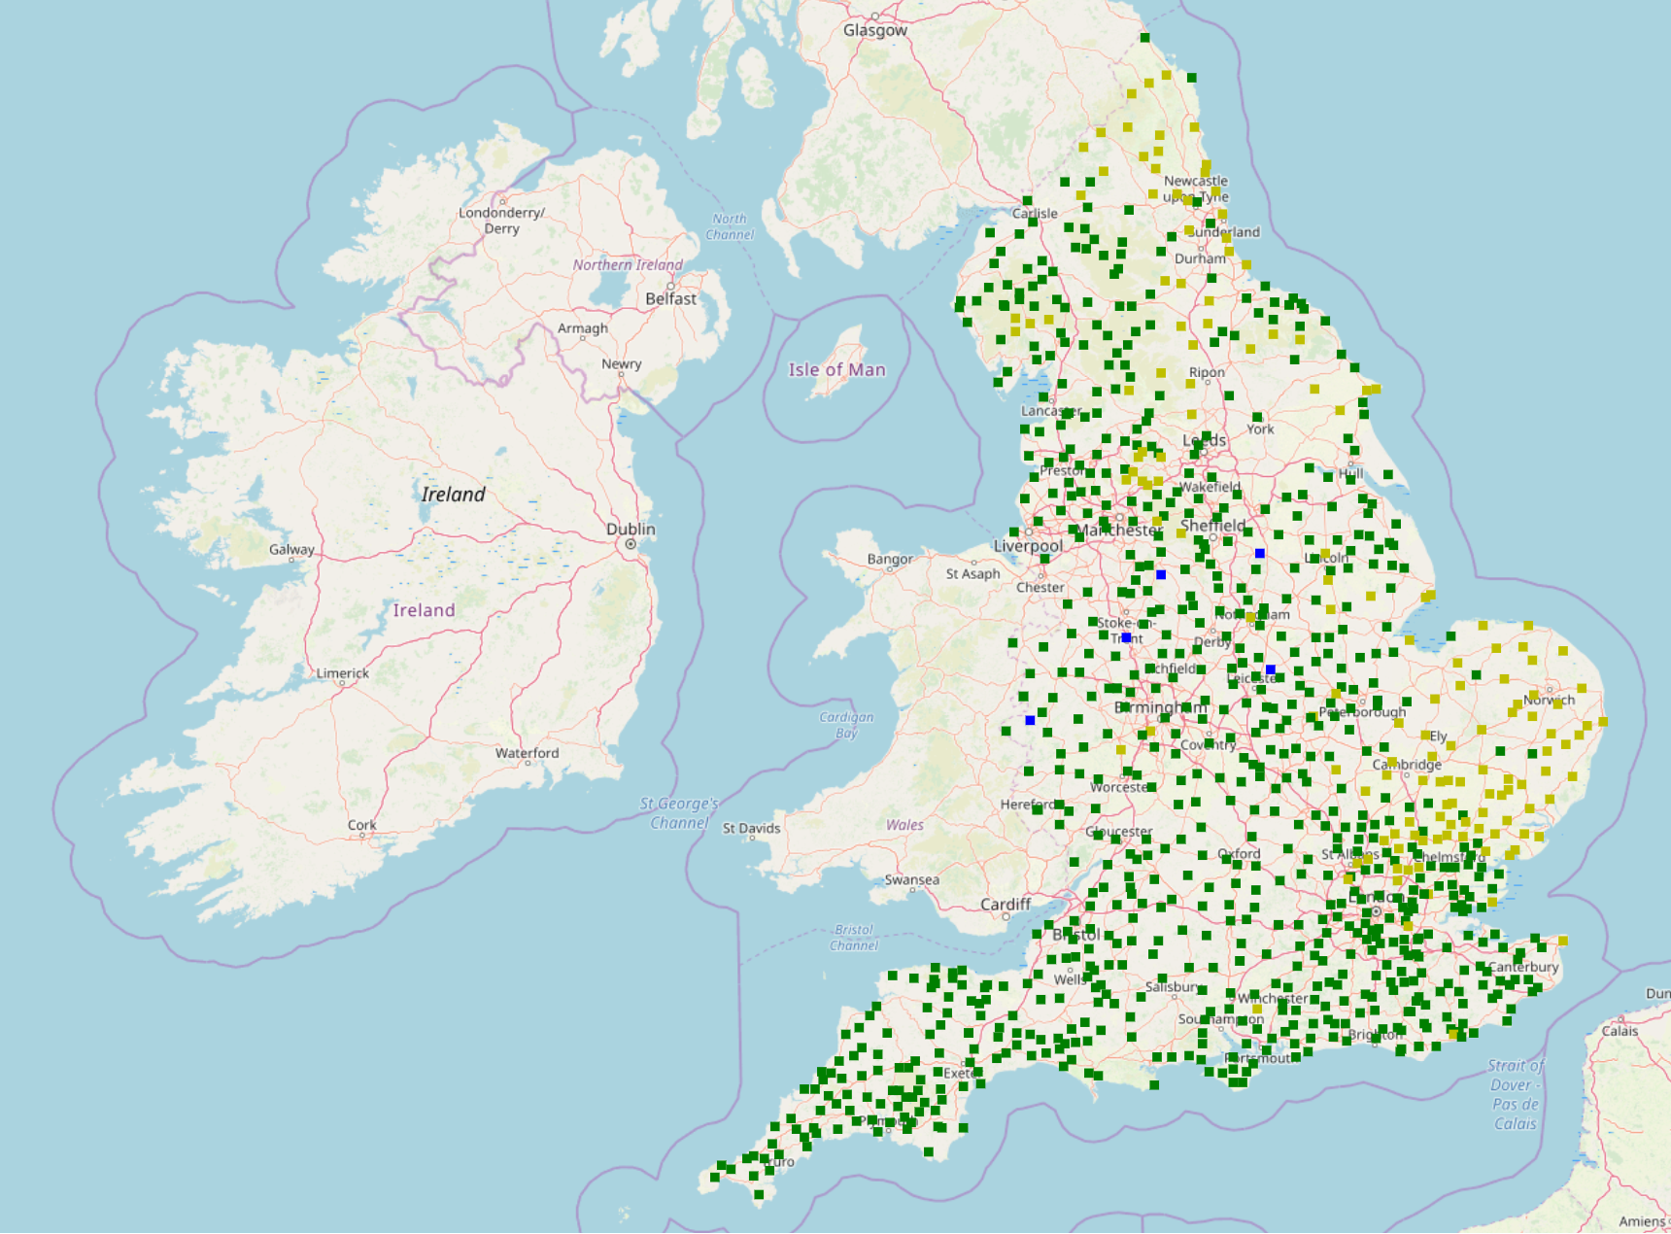




Flood Tool
Level of Rainfall
High
Medium
Low
Very low
None
Graphs showing the rainfall values for the nearest station to an input postcode over the past 20 days, along with a flood alert.
Map of rainfall levels at every station, for 6th October 2019.

